Slide 1
Matlab Topics
7/17/2023

Slide 2
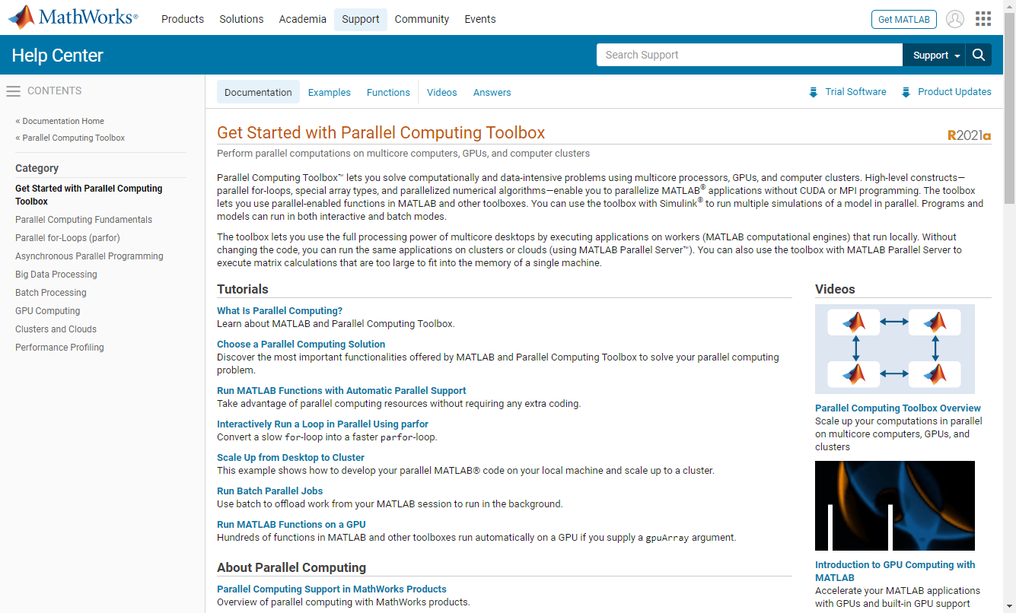
Parallel Processing Toolbox

Slide 3
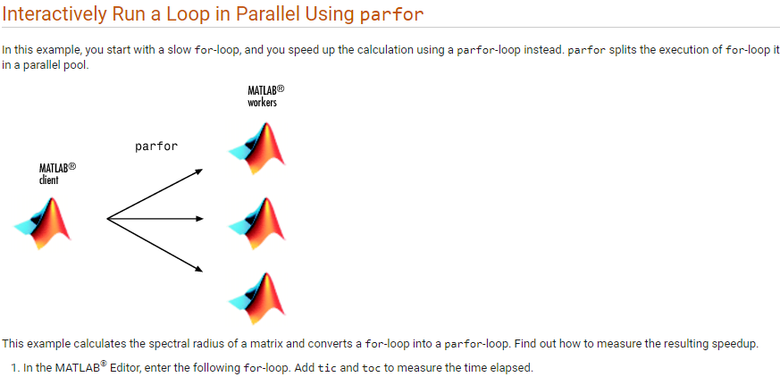
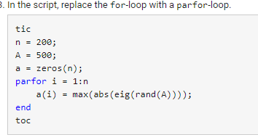

Slide 4

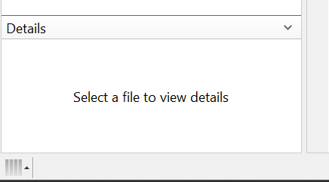
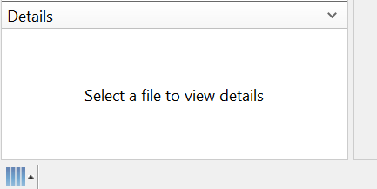
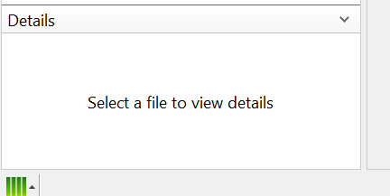
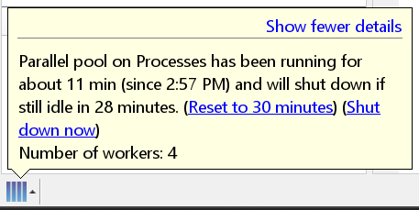
Parallel computing
Parallel Pool icon
Idle
Active
Info

Slide 5

Parallel computing: example

Slide 6
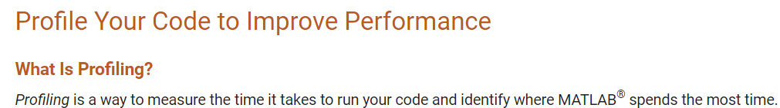
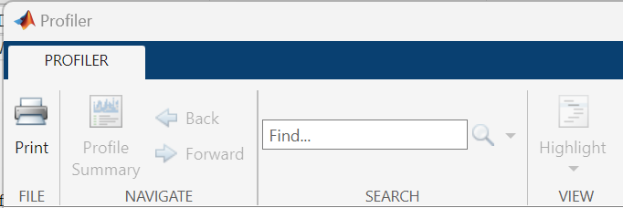
Code Profile

Slide 7
Code profile: example
Use ‘solvelotka.m’ example for Profiler
This example is contained within the documentation for Profiler

Slide 8
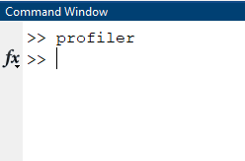
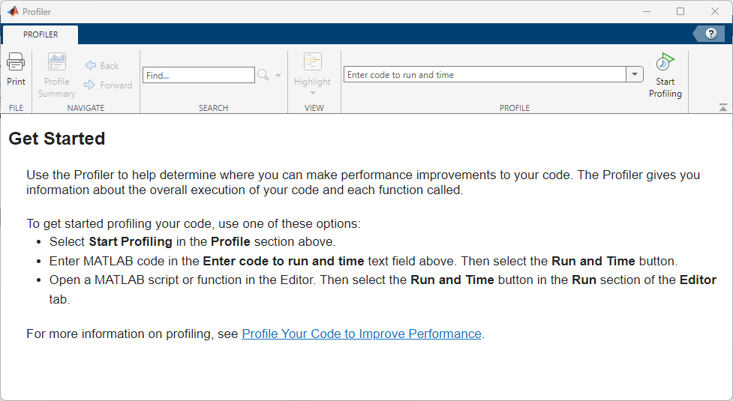
Run function with inputs in Profiler

Slide 9
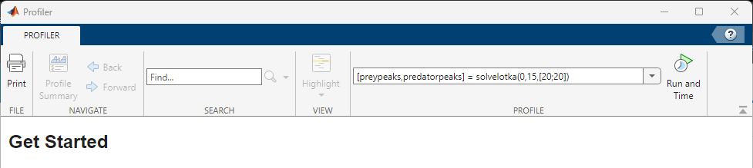
Run solvelotka.m example
Inputs: [preypeaks, predatorpeaks] = solvelotka(0,15,[20;20])

Slide 10
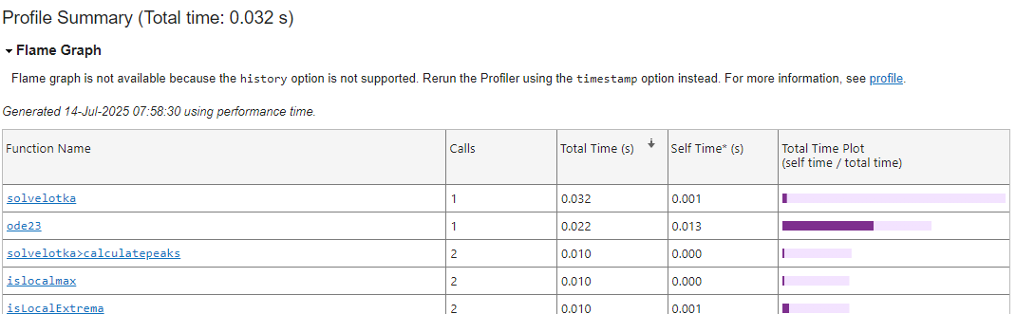
Explore function calls for efficiency
Click

Slide 11
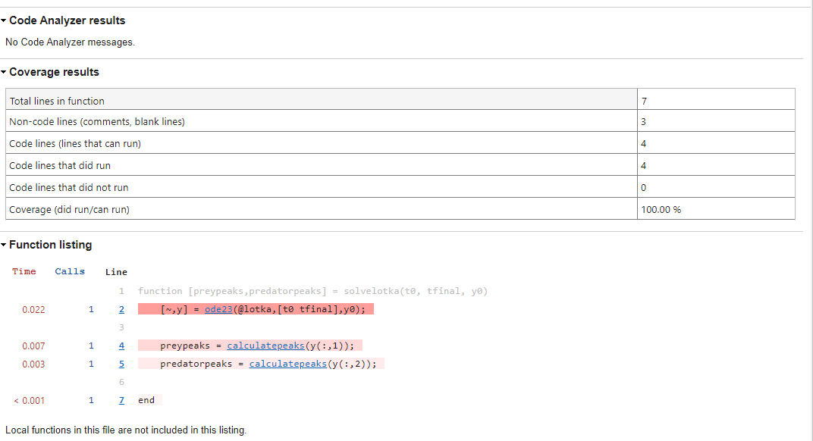
Explore the code line by line

